Slide 1
CSS TRAINING
Rangaraj Kaushik Sundar

Slide 2
WHY DO YOU WANT TO LEARN CSS?

Slide 3
What are we going to learn today?
CSS Basics (from previous session)
CSS Grid, Flexbox and Media Query - Conceptually
Exercise – Personal Website

Slide 4
“When you code CSS, you’re writing abstract rules to take unknown content and organize it in an unknown medium.
That shit is hard!”
Keith J Grant
Author of CSS in Depth

Slide 5


Slide 6
Talking points
Third party libraries
CSS Basics
Browser Support
CSS Validation and Debugging

Slide 7
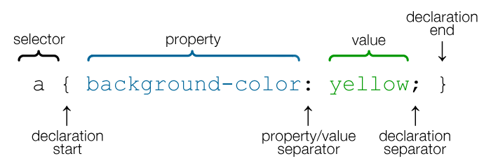
CSS Property and Value

Slide 8
CSS LAYOUTS

Slide 9

The Revolutionary Grid Layout

Slide 10

Flex Boxes

Slide 11

Media Queries

Slide 12
LET’S CODE!

